Slide 1
Activity Analyzer
Project No. 80
Mentor: Dr. Amit Rathi
5th Semester Minor Project by:
Anubhav Singh(161B039)
Mrigank Singh(161B124)
Sidharth Gupta(161B235)

Slide 2
Table of Content
Introduction
Setting Research Goal
Scope
Tools Used
Data Analysis
Dataset
Plotting And Visualisation
User Interface
Future Work
References

Slide 3
Introduction
This is our 5th semester project done under the guidance of Dr. Amit Kumar Rathi.
A web application based on implementation of Data analysis and Machine learning algorithms.

Slide 4
Setting The Research Goal
The aim of this project is to get familiarized with a Data Science process by building & deploying a Machine Learning Model that can predict a House price
Based on its features, by trying different regression models and choosing the one with best prediction score.

Slide 5
Scope
For the time our project is a prototype model which is restricted to predicting Housing prices (on limited parameters )only.

Slide 6
Tools Used
Language : Python, HTML, CSS
Web Framework: Flask
Text Editors: Sublime
IDE: Pycharm, Jupyter, Python Shell

Slide 7
Tools Used
Python Distribution
Anaconda
Python Packages and Libraries
Numpy
Pandas
Matplotlib
Sci-kit Learn

Slide 8
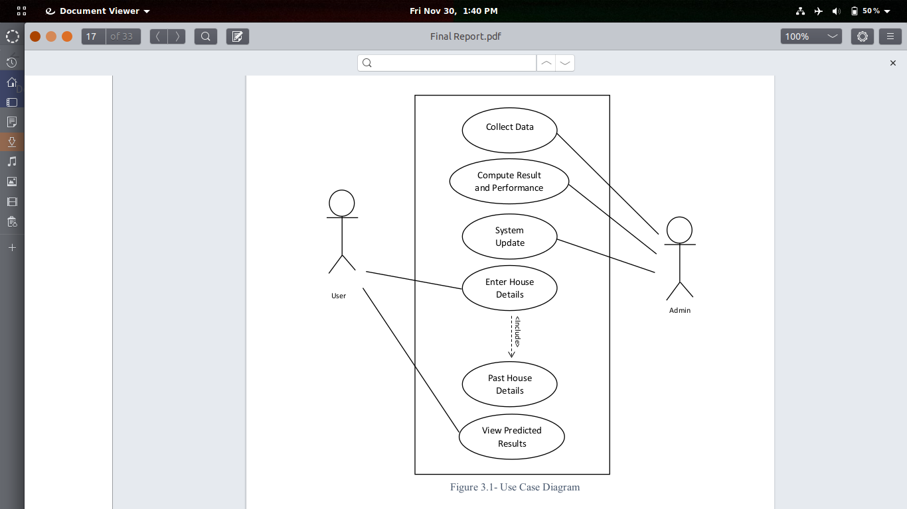
Use Case Diagram of Activity Anlayzer

Slide 9
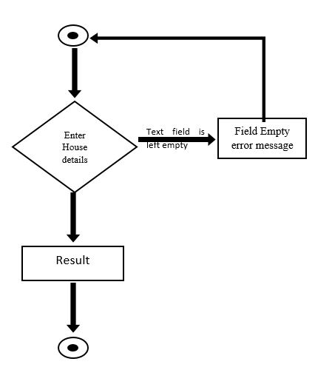
Activity Diagram of Activity Anlyzer

Slide 10
Data Analysis
Data is the foundation of the Digital Age.
Data analysis is the process of extracting information from data.
Its multiple stages includes :
Establishing a data set
Preparing the data for processing
Applying models
Identifying key findings
Creating reports.

Slide 11
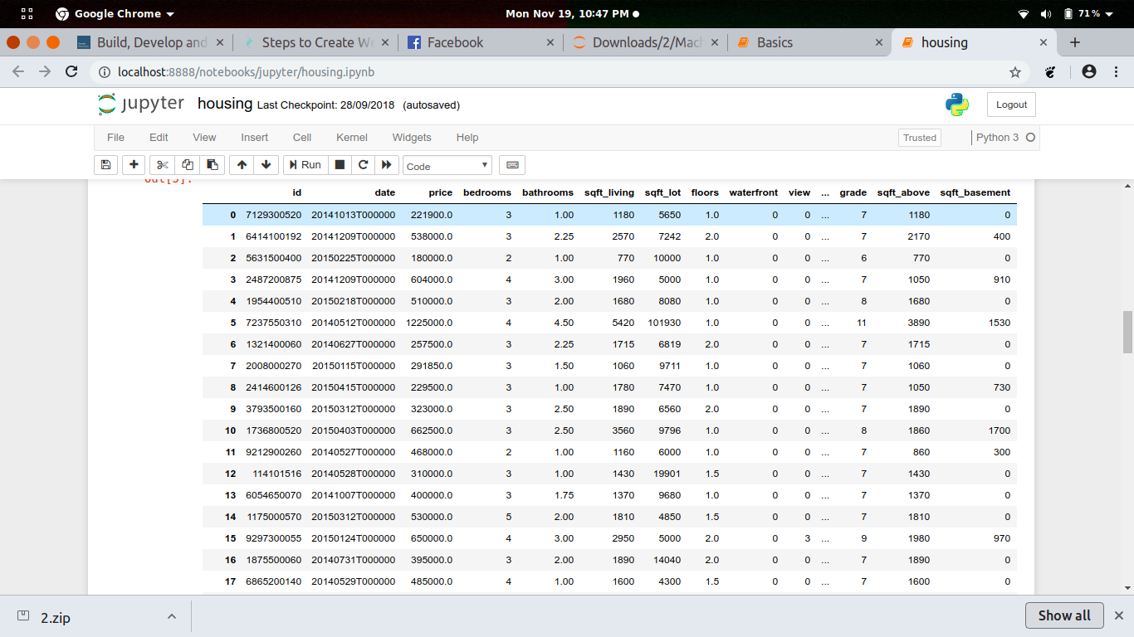
Dataset

Slide 12
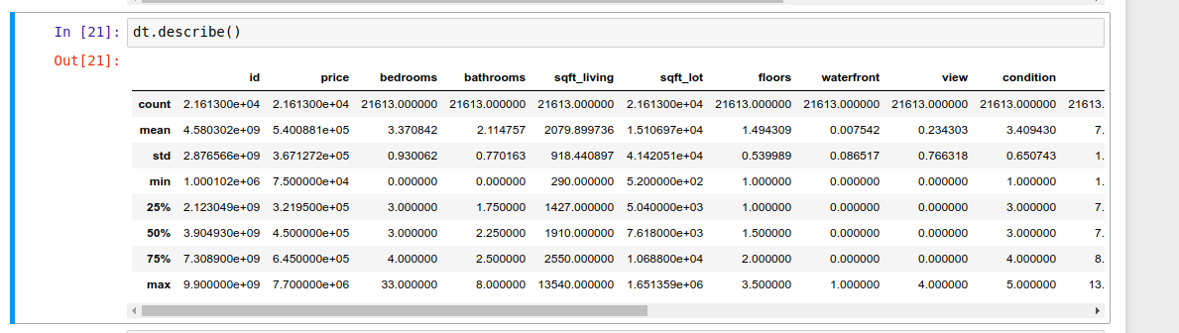
Plotting and Visualization
describe( ) Function gives the mean, std and IQR values. It excludes character column and calculate summary statistics only for numeric columns

Slide 13
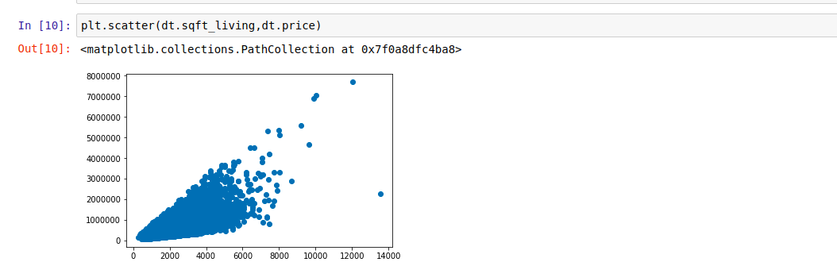
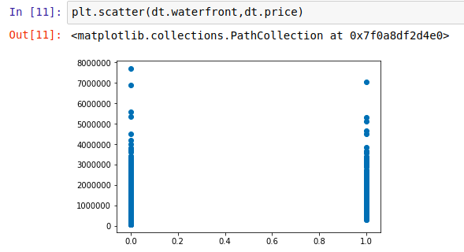
plt.scatter( ): Instead of points being joined by line segments, in scatter plots the points are represented individually with a dot, circle, or other shape.

Slide 14
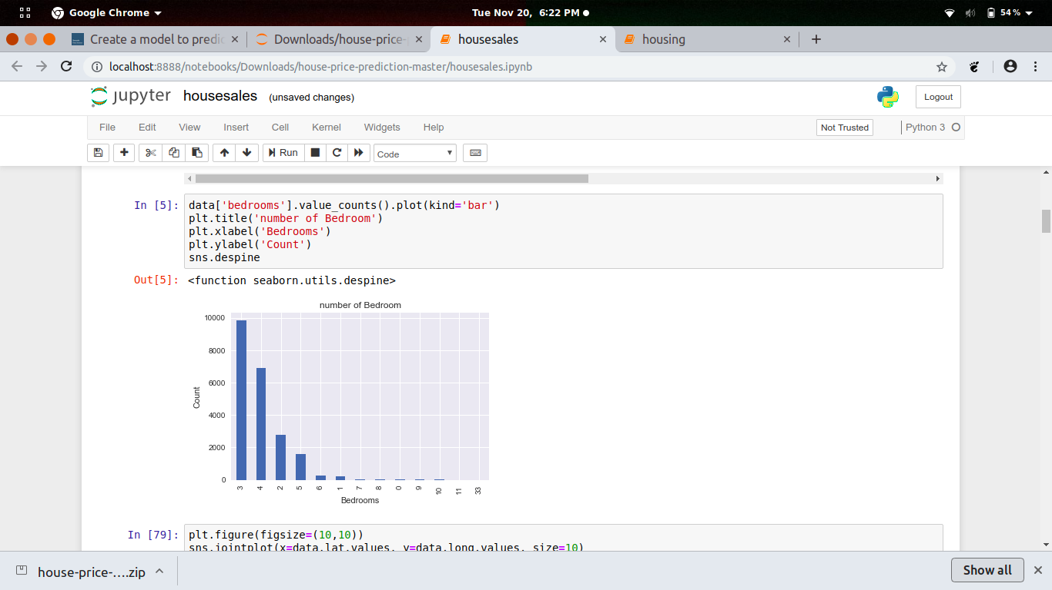
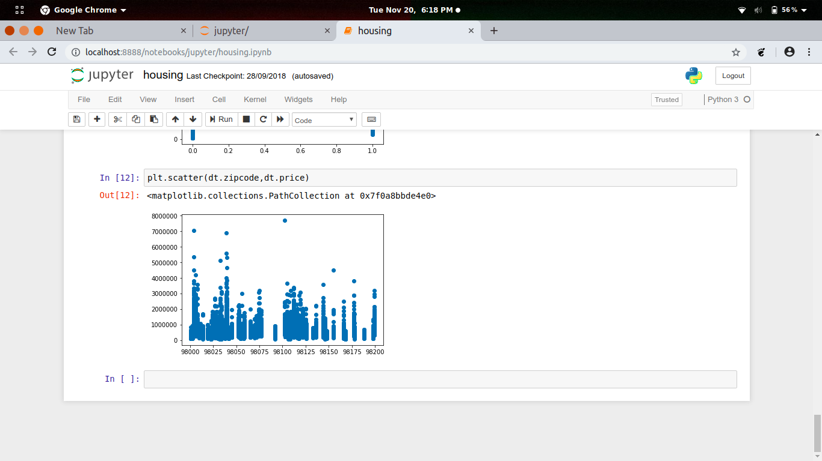
pandas.Series.value_counts( ): The resulting object will be in descending order so that the first element is the most frequently-occurring element.

Slide 15
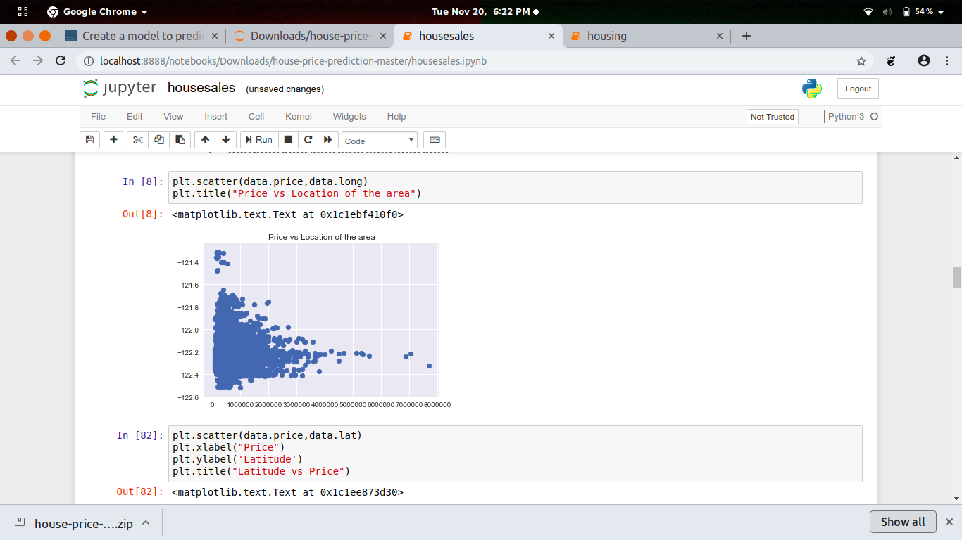
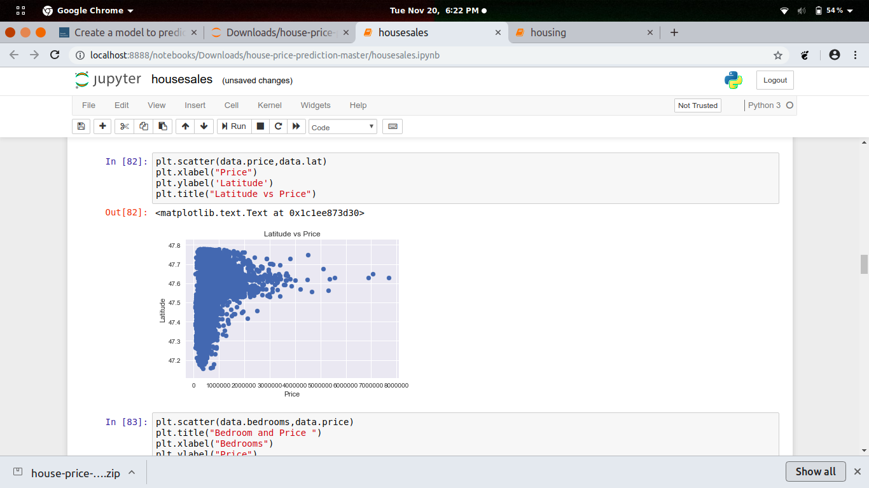

Slide 16
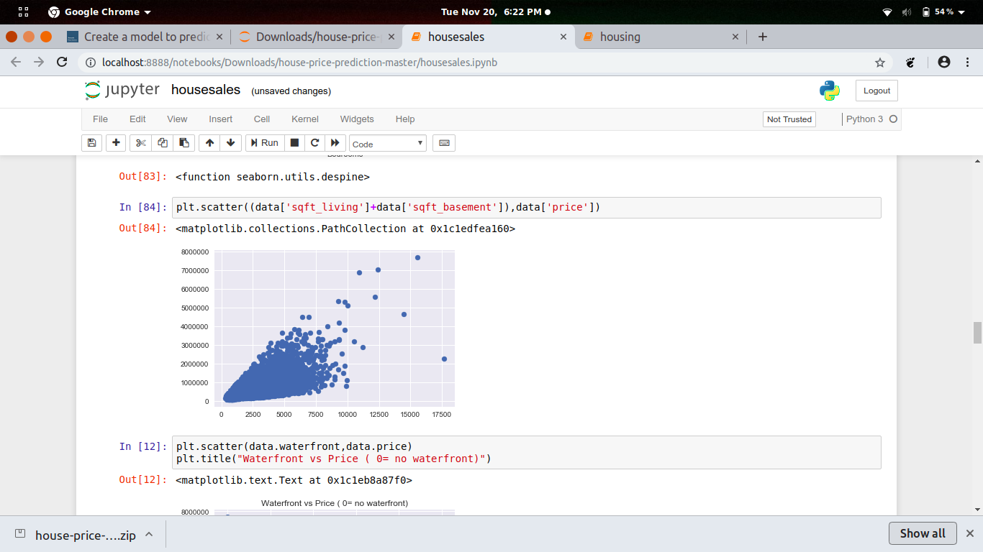
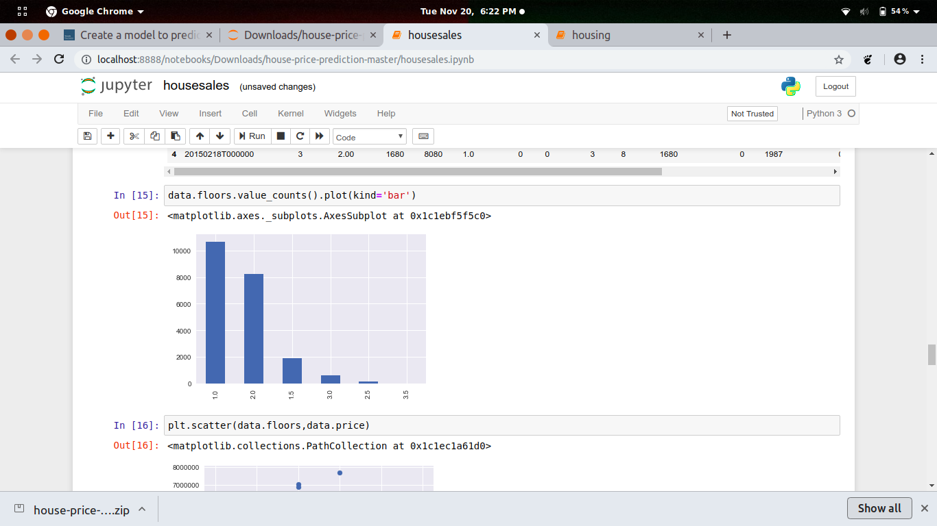

Slide 17
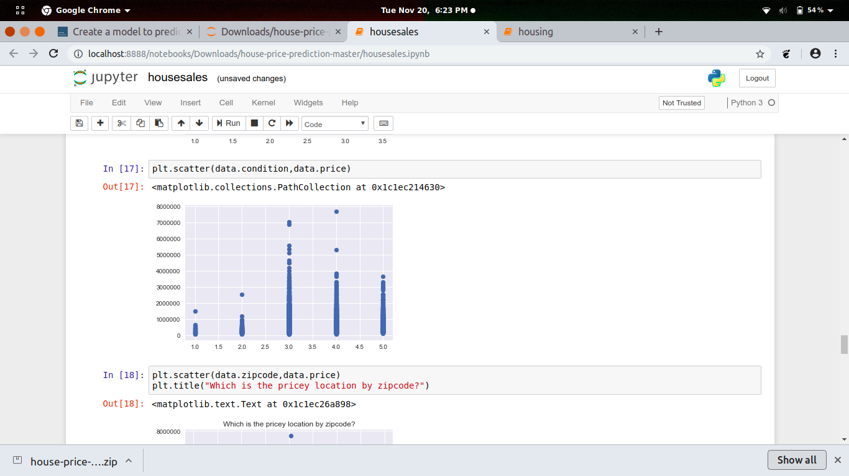
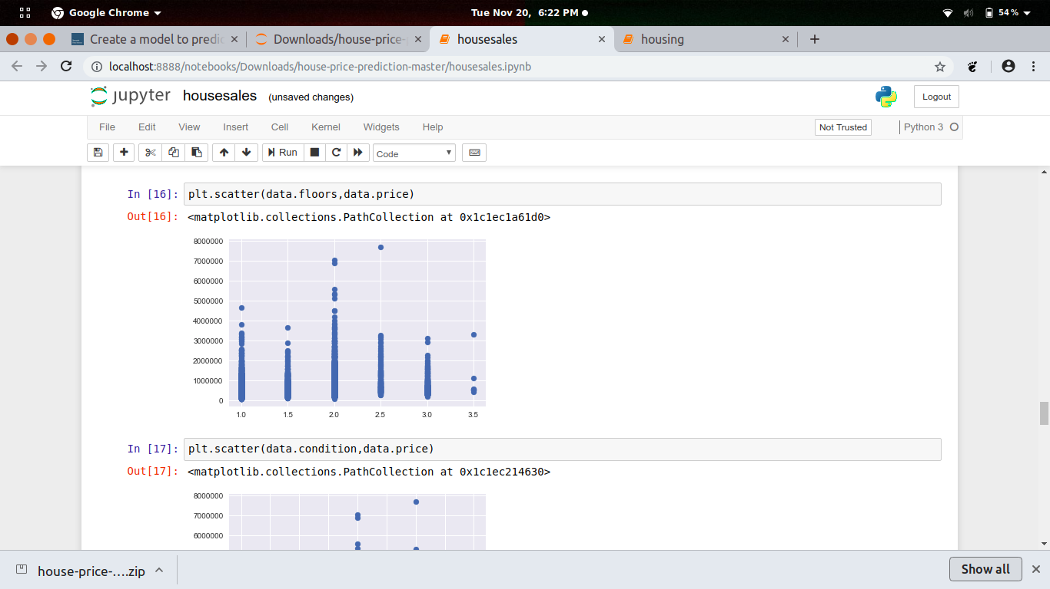

Slide 18
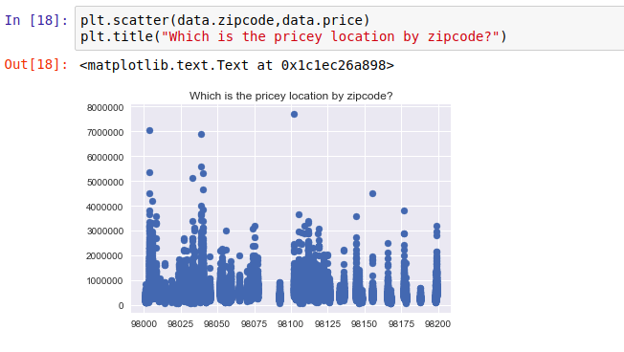

Slide 19
Now that we are familiar with factors influencing price of the house, we will use linear regression as statistical model for prediction of price.
Regression works on the line equation , y=mx+c.
The variable we are predicting is called the criterion variable and is referred to as Y.
The variable we are basing our predictions on is called the predictor variable and is referred to as X.

Slide 20
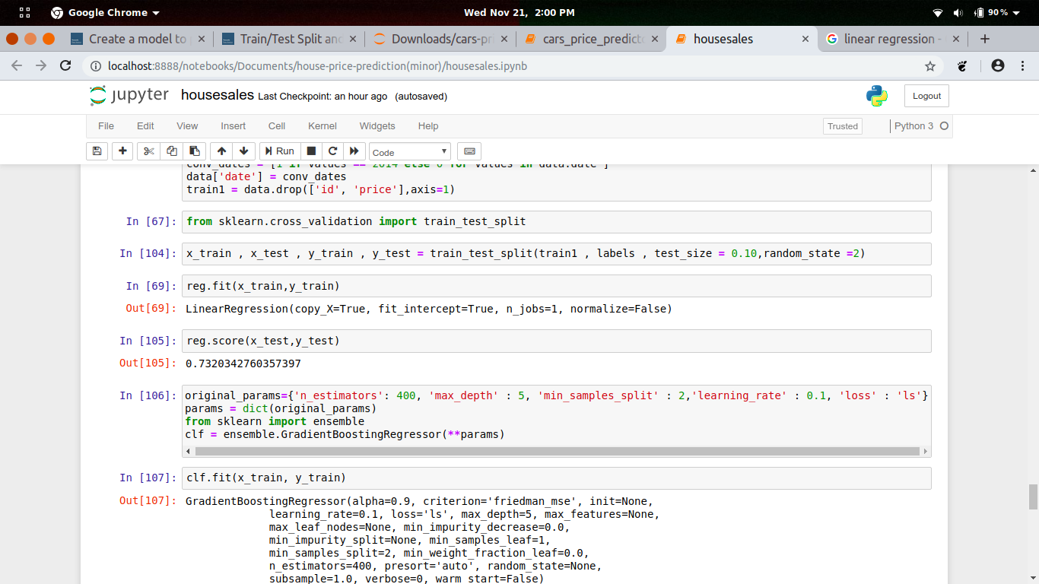
Fitting our data to linear regression model we get prediction score as 73%.
The accuracy of the model is lower than our aim of 85.
This tells that our model is weak prediction model.

Slide 21
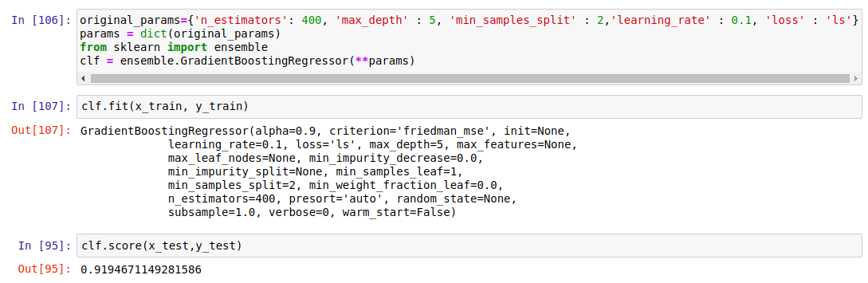
We use a different method , which is very important for weak prediction models such as this.
We use gradient boosting regression.
After using gradient boosting regression we get a accuracy score of 91%.

Slide 22
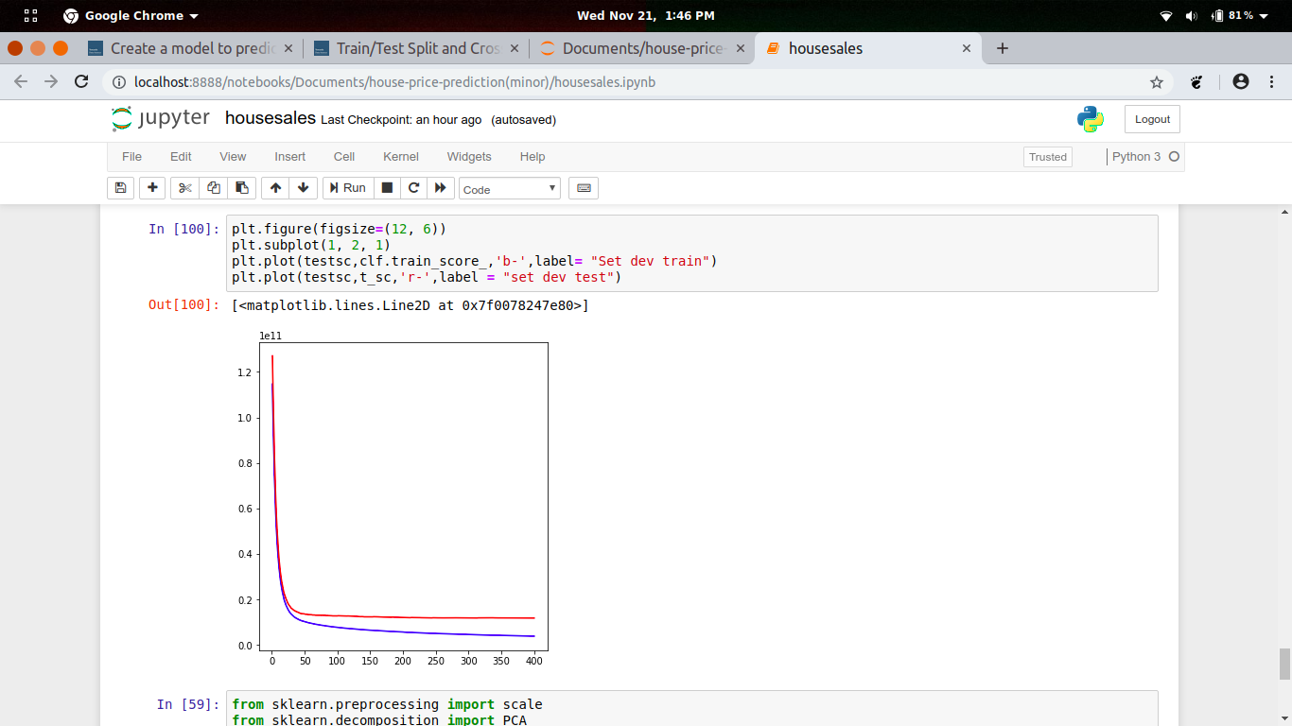
Comparision between Real price and predicted price.

Slide 23
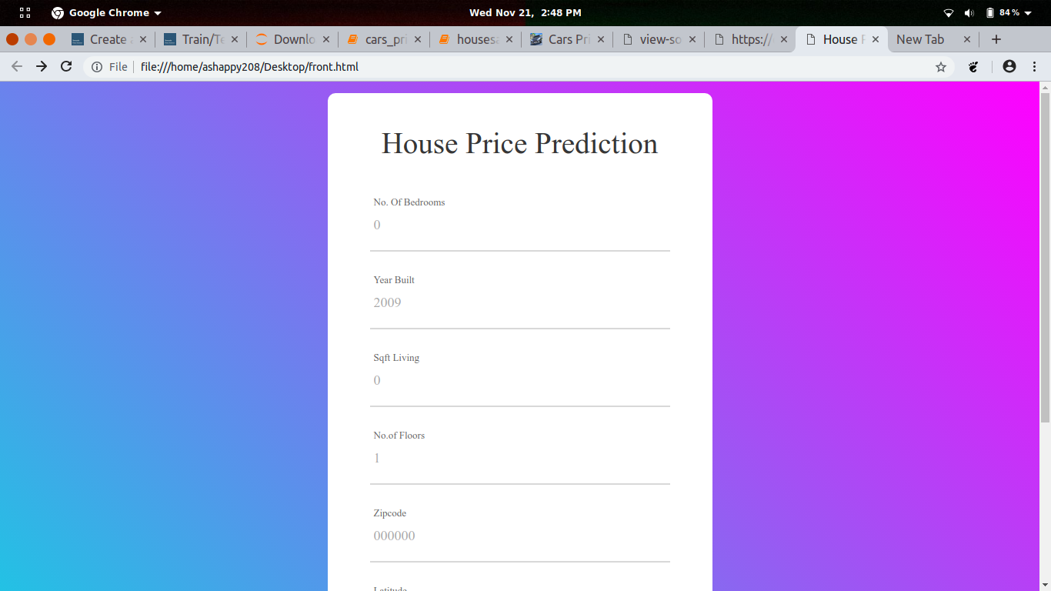
House price prediction user interface

Slide 24
Future Work
Despite having produced a working application that met our initial requirements, various improvements can be made in the future.
We would need to seek alternative sources of data besides publicly available dataset, which can provide us with information on the area, the number of rooms, etc for each property.
Economic factors such as the yearly inflation rate or GDP growth can also be considered.

Slide 25
References
Introduction to Python for Data Science by edX
Python for Data Analysis by Wes McKinney
Doing Data Science by Rachel Schutt & Cathy O’Neil
House Pricing Dataset by Kaggle
Web Development Course By Colt Steele
Course on Django

Slide 26
Thank You.

